Slide 1
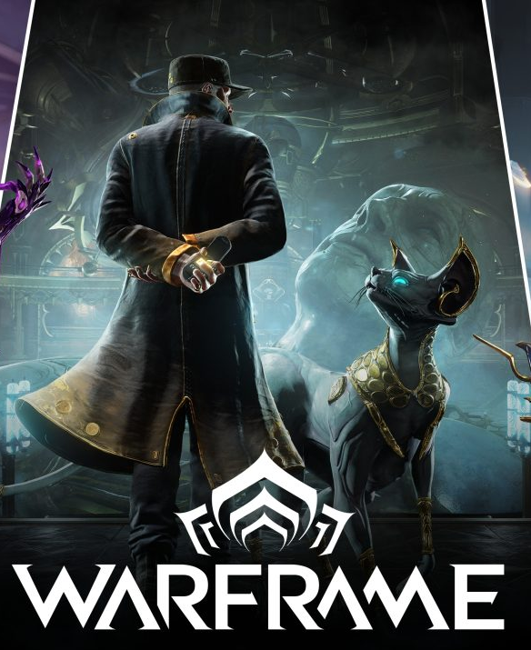

Warframe Trading Hub
Trading website – MSIS4013.O21.CTTT
Lecturer: Dr. Nguyen Thanh Binh

Slide 2
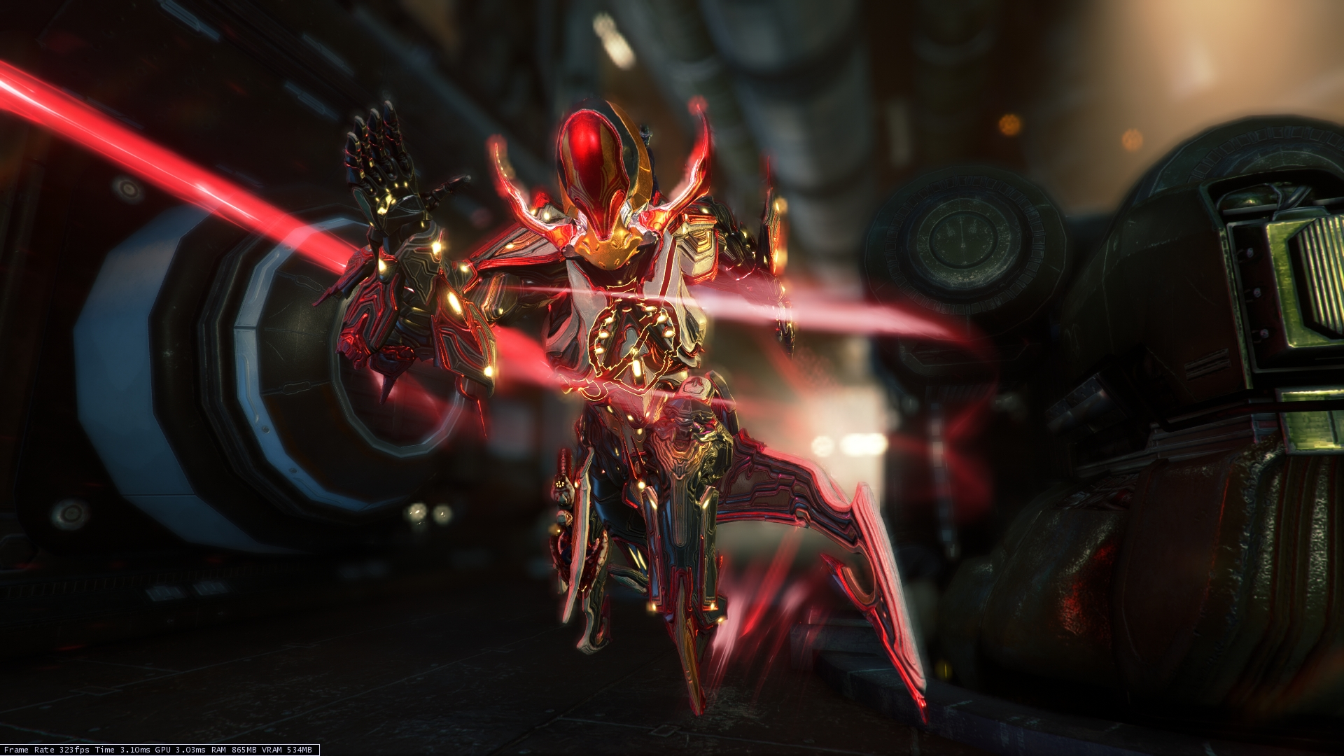
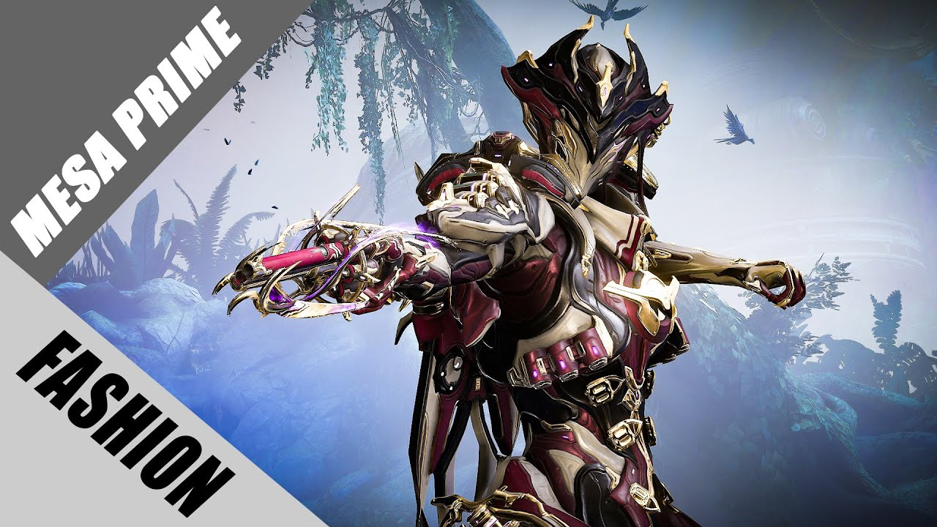
About Us
Le Huu Bach
Le Nguyen Gia Hung

Slide 3
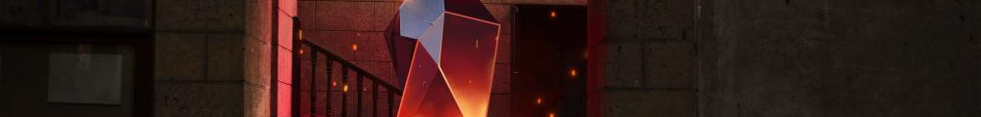
Table of contents
01
About
02
Review
03
Method
04
Result

Slide 4
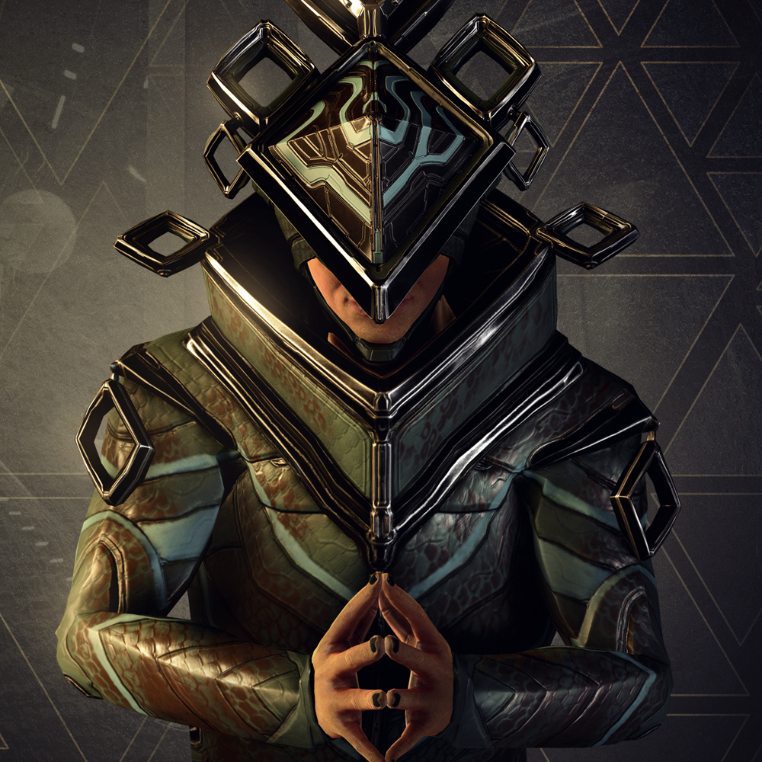
01
About our Project

Slide 5
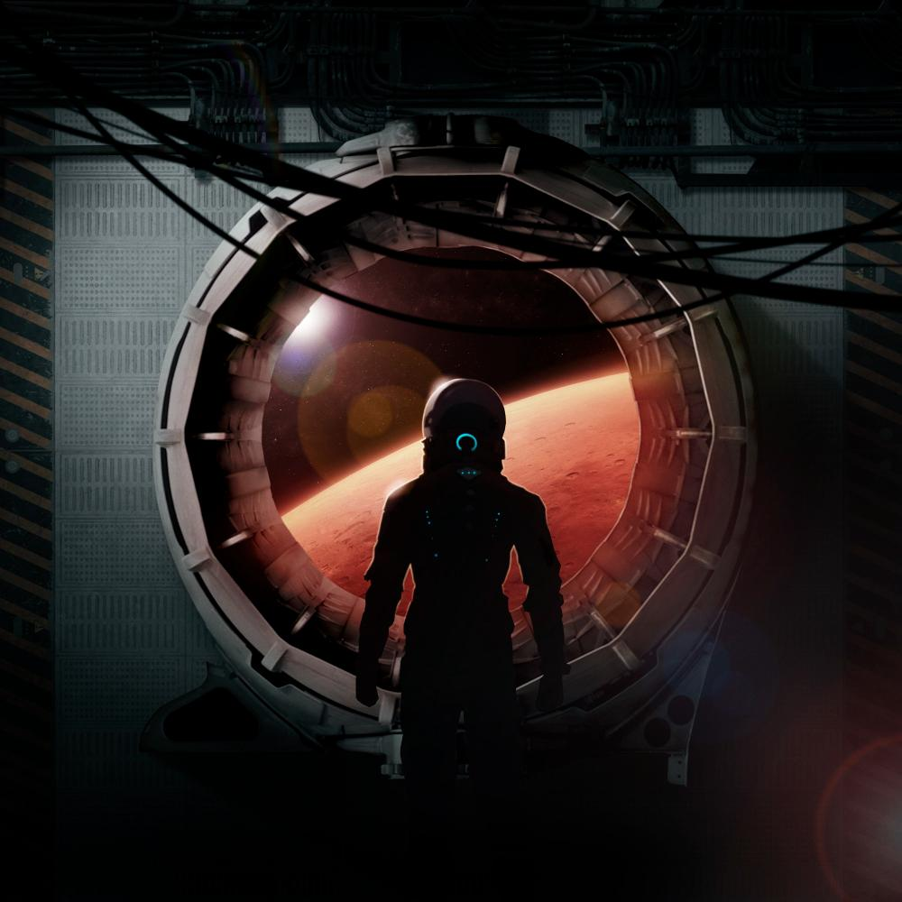
About the website
The website is all about trading, buying, selling, and STONK
A place to find needed item
Also to sell
Free for all
Trades can be found here, but will be done
in game
A perfect website for those who want to earn shining overkill merchs with more affordable price (or for those who want to sell them to people)

Slide 6
Scope
Interface
Idea
Target
Organized sections
Vibrant color code for specific tasks
A Trading Platform
Item Price Suggestion
Quick Buy features
Warframe Trader
Those who need fast process
Those who new to Trade

Slide 7
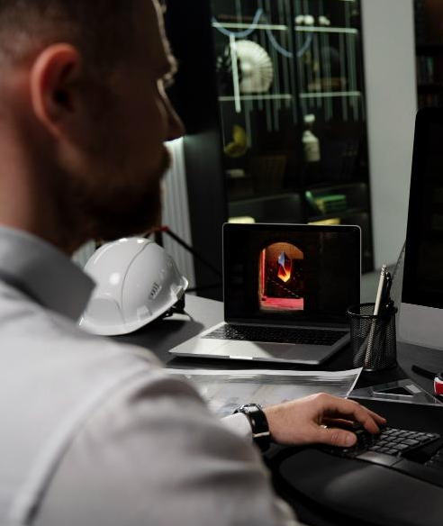
02
Literature review

Slide 8
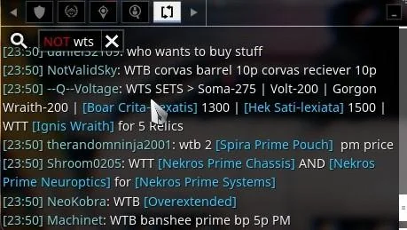
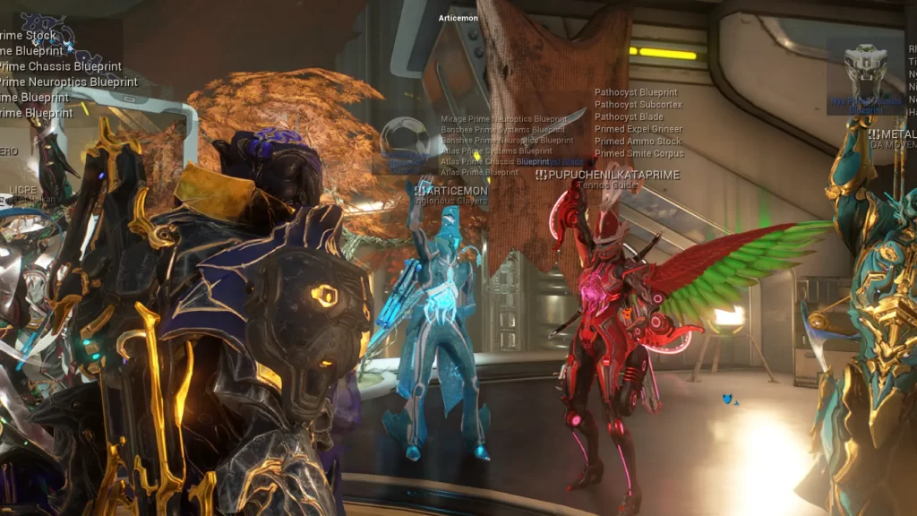
Problems
In-game trading functions are hard to use and not newbie-friendly
Not productive for trading

Slide 9
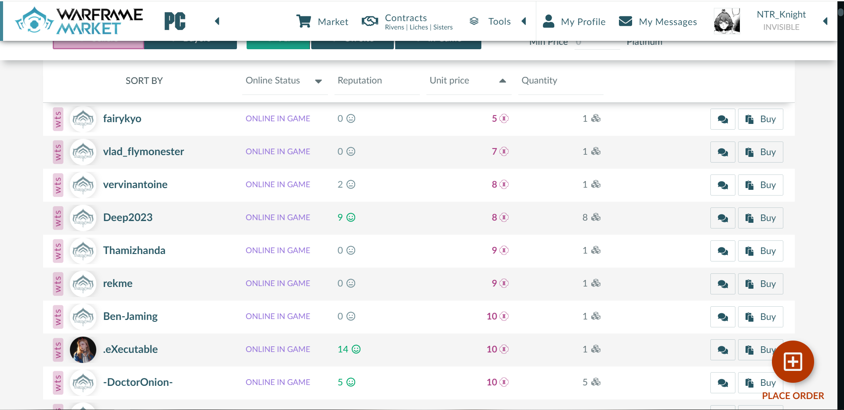
Motivation
The popular trading website that is used by everyone is warframe.market.
However, they still lack features to enhance user experience

Slide 10
Warframe Trading Hub
Wanting to create something better, with faster trading process, easier to look for items, greater in user interface

Slide 11
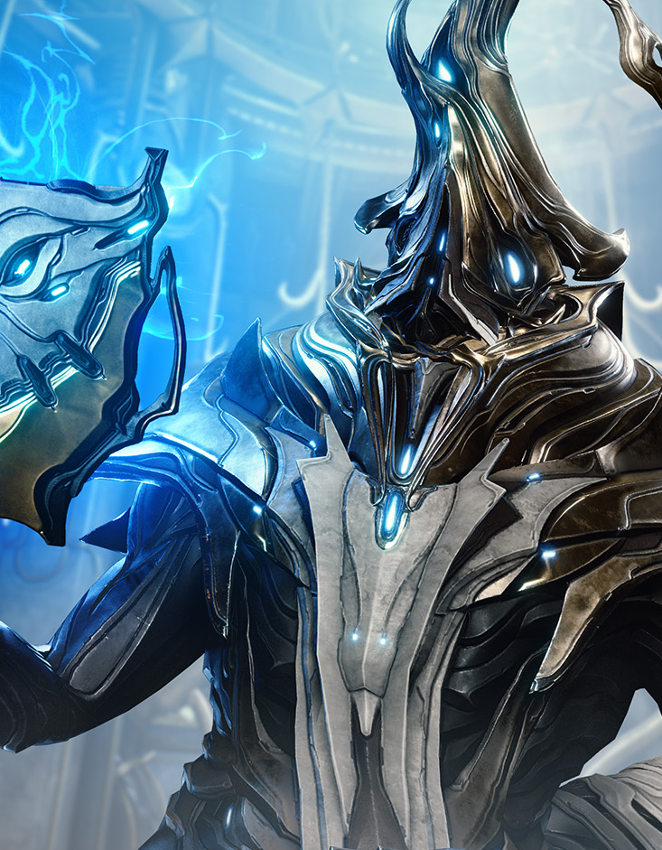
03
Methods

Slide 12
Timeline
Prototype
Scope
Designing the web UI
Creating tables
Apply
Look for what will we actually do to design the web
Make them come true
Step 02
Step 01
Step 03

Slide 13
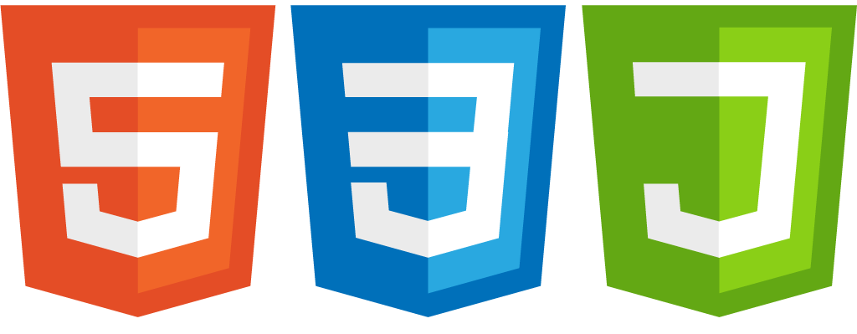
Technologies
For web-based application

Slide 14



Technologies
UI design, hook, event handler
Database Management

Slide 15
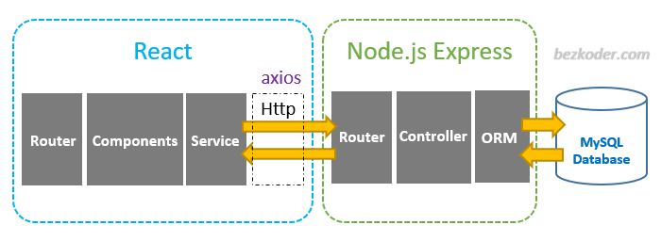
Architecture

Slide 16
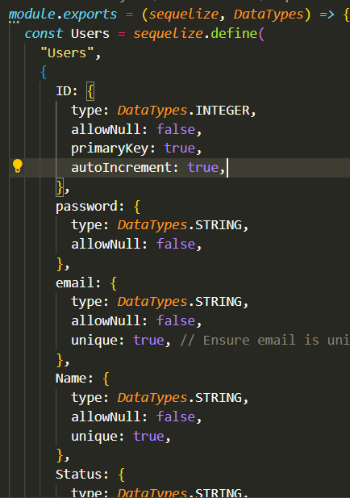
Application of Database Design
Sequelize

Slide 17
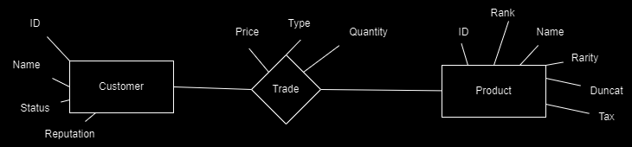
Diagram

Slide 18
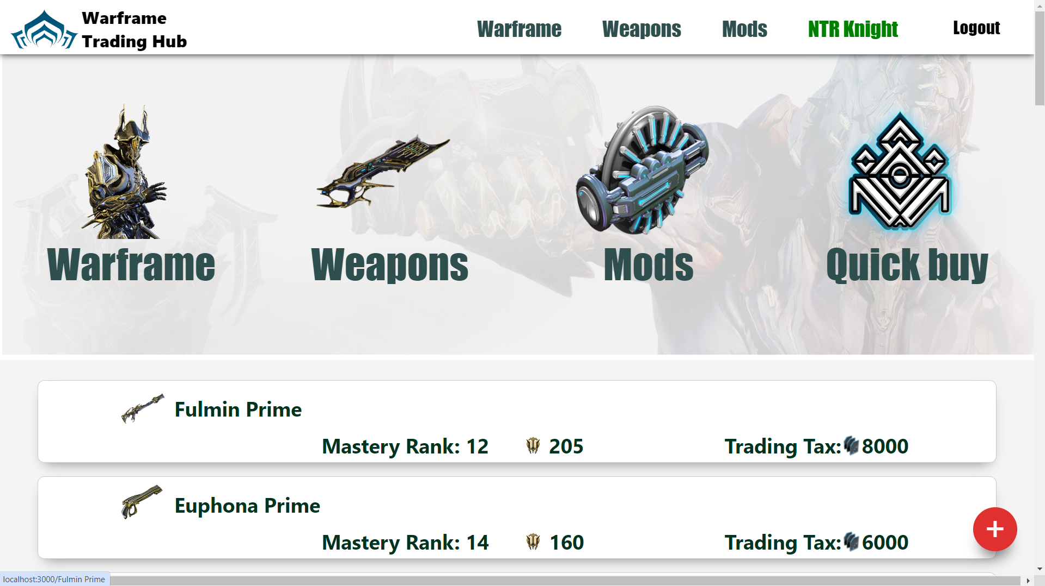
Interface

Slide 19
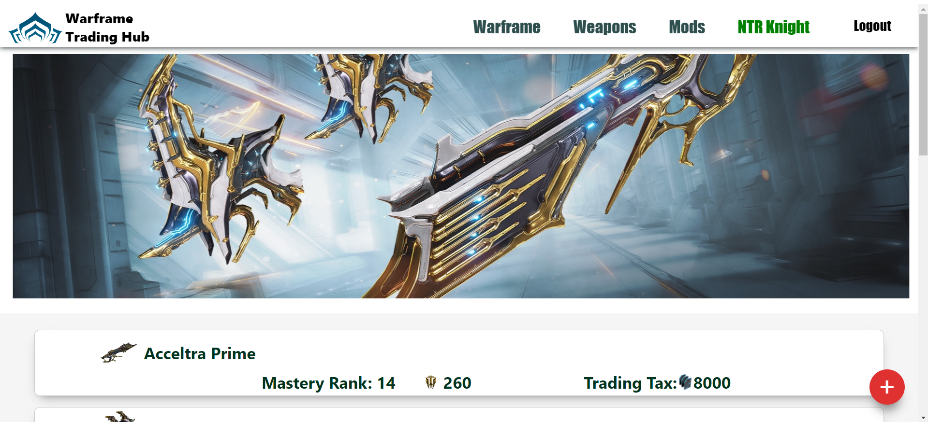
Interface

Slide 20
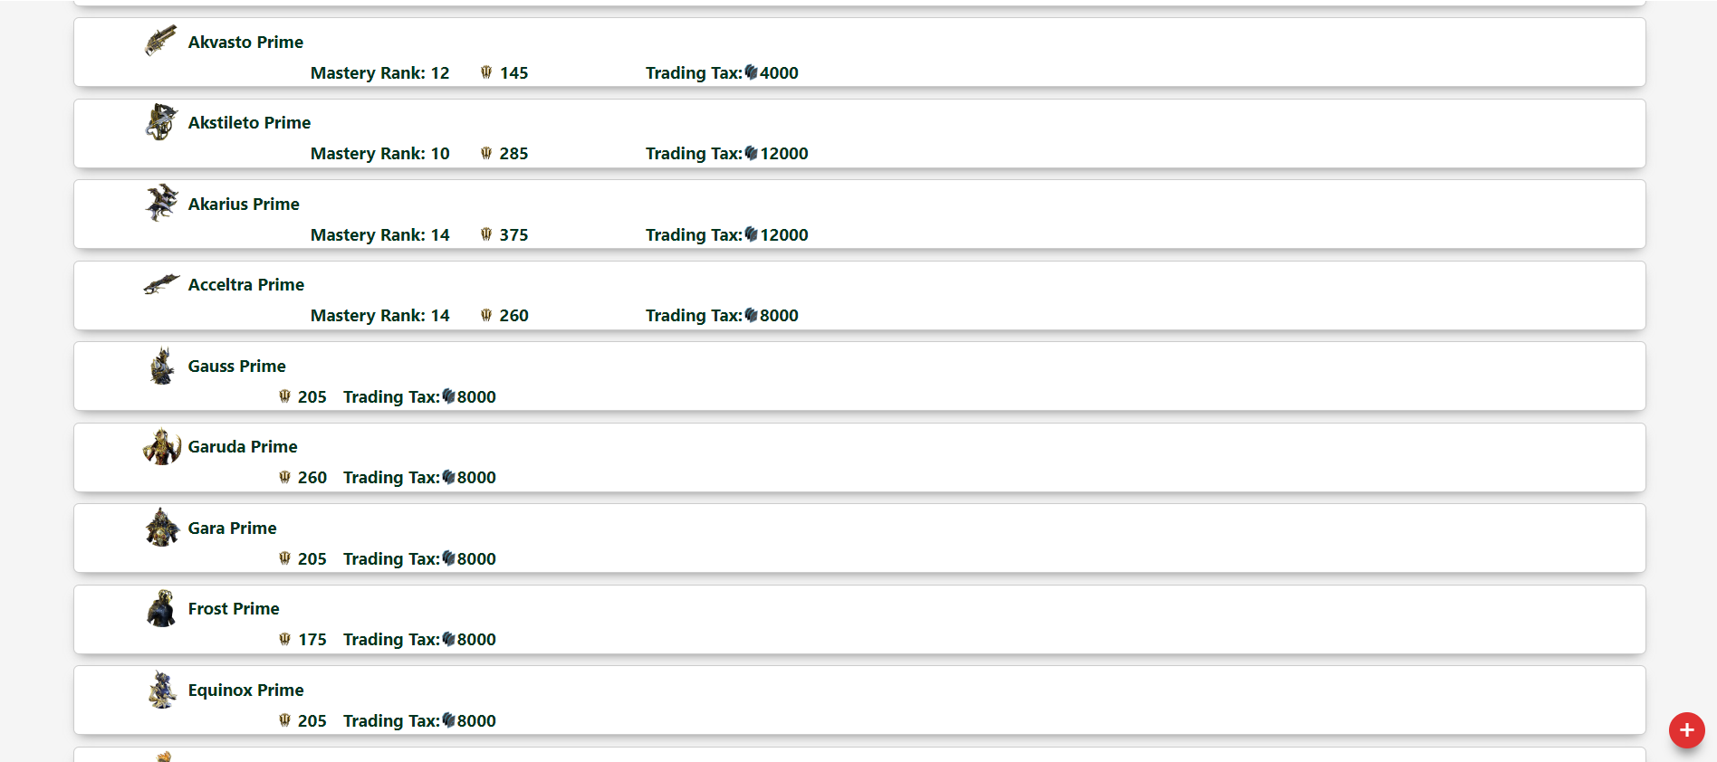
Interface

Slide 21
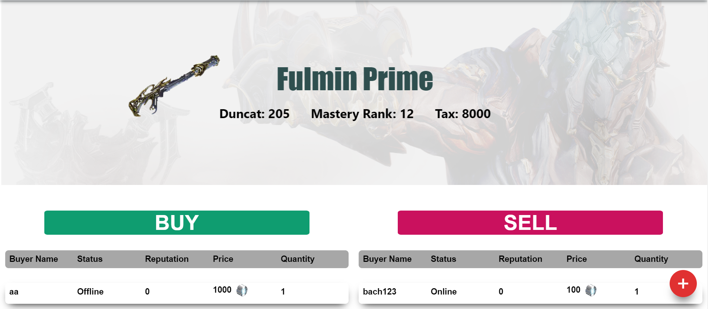
Interface

Slide 22
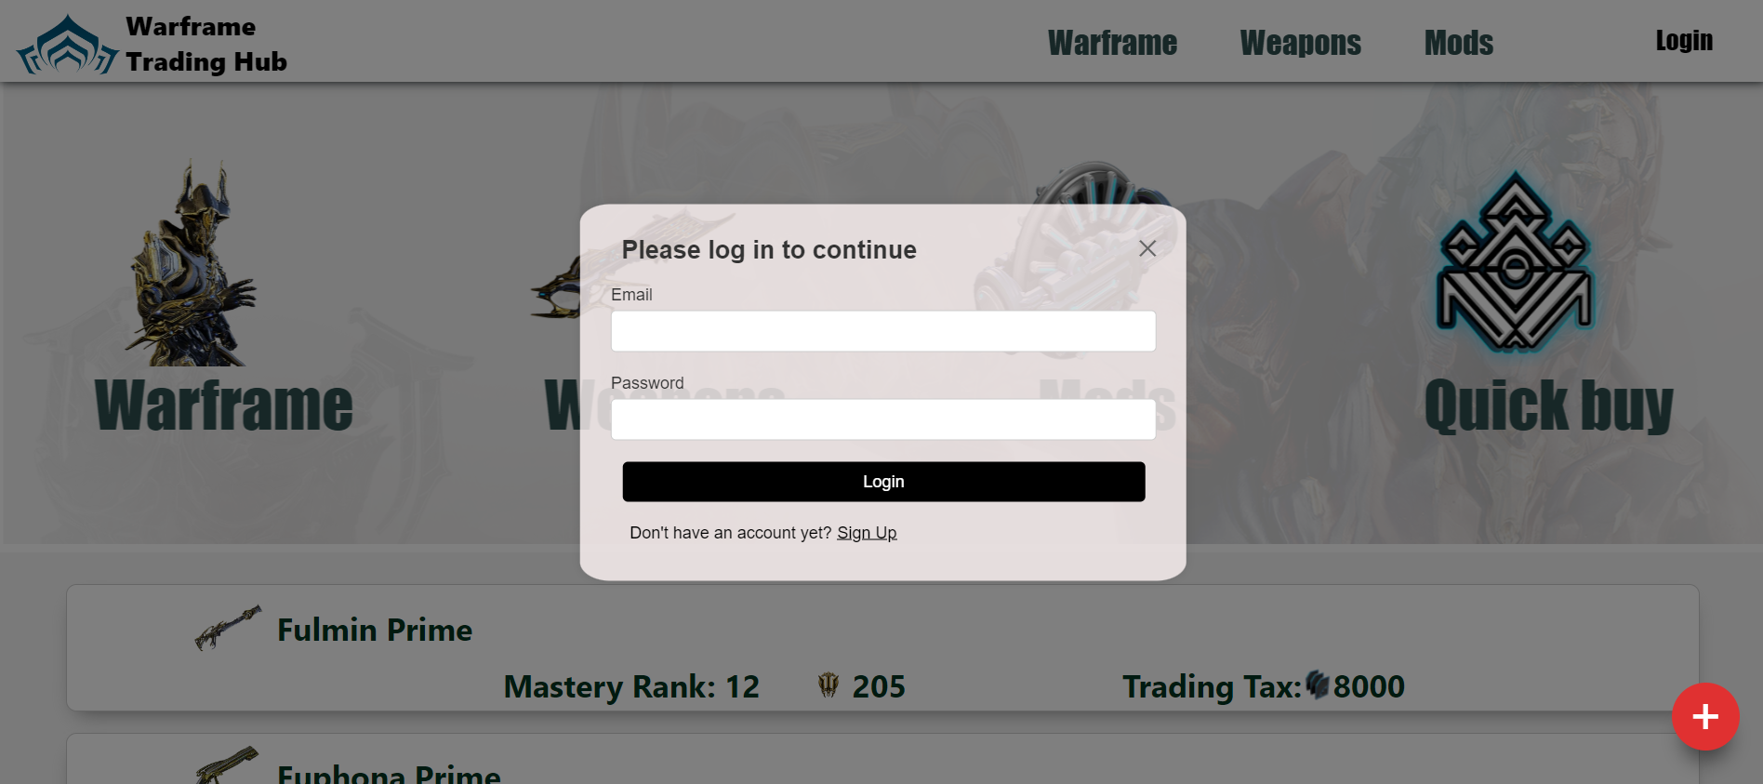
Interface

Slide 23
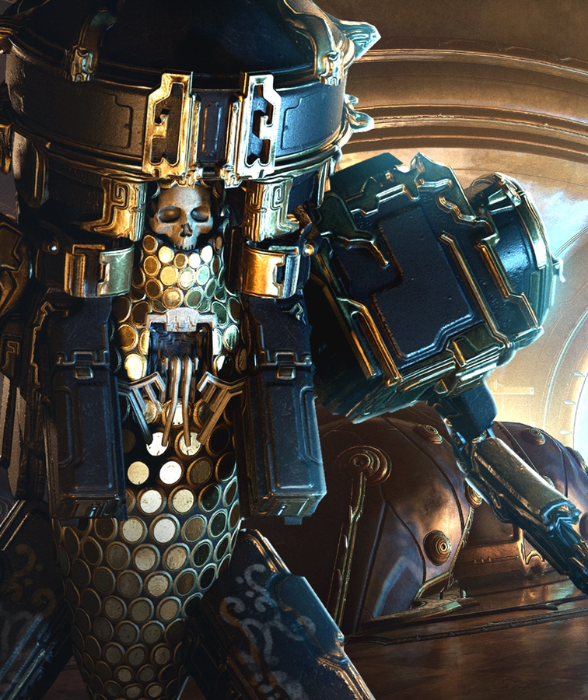
04
Conclusion

Slide 24
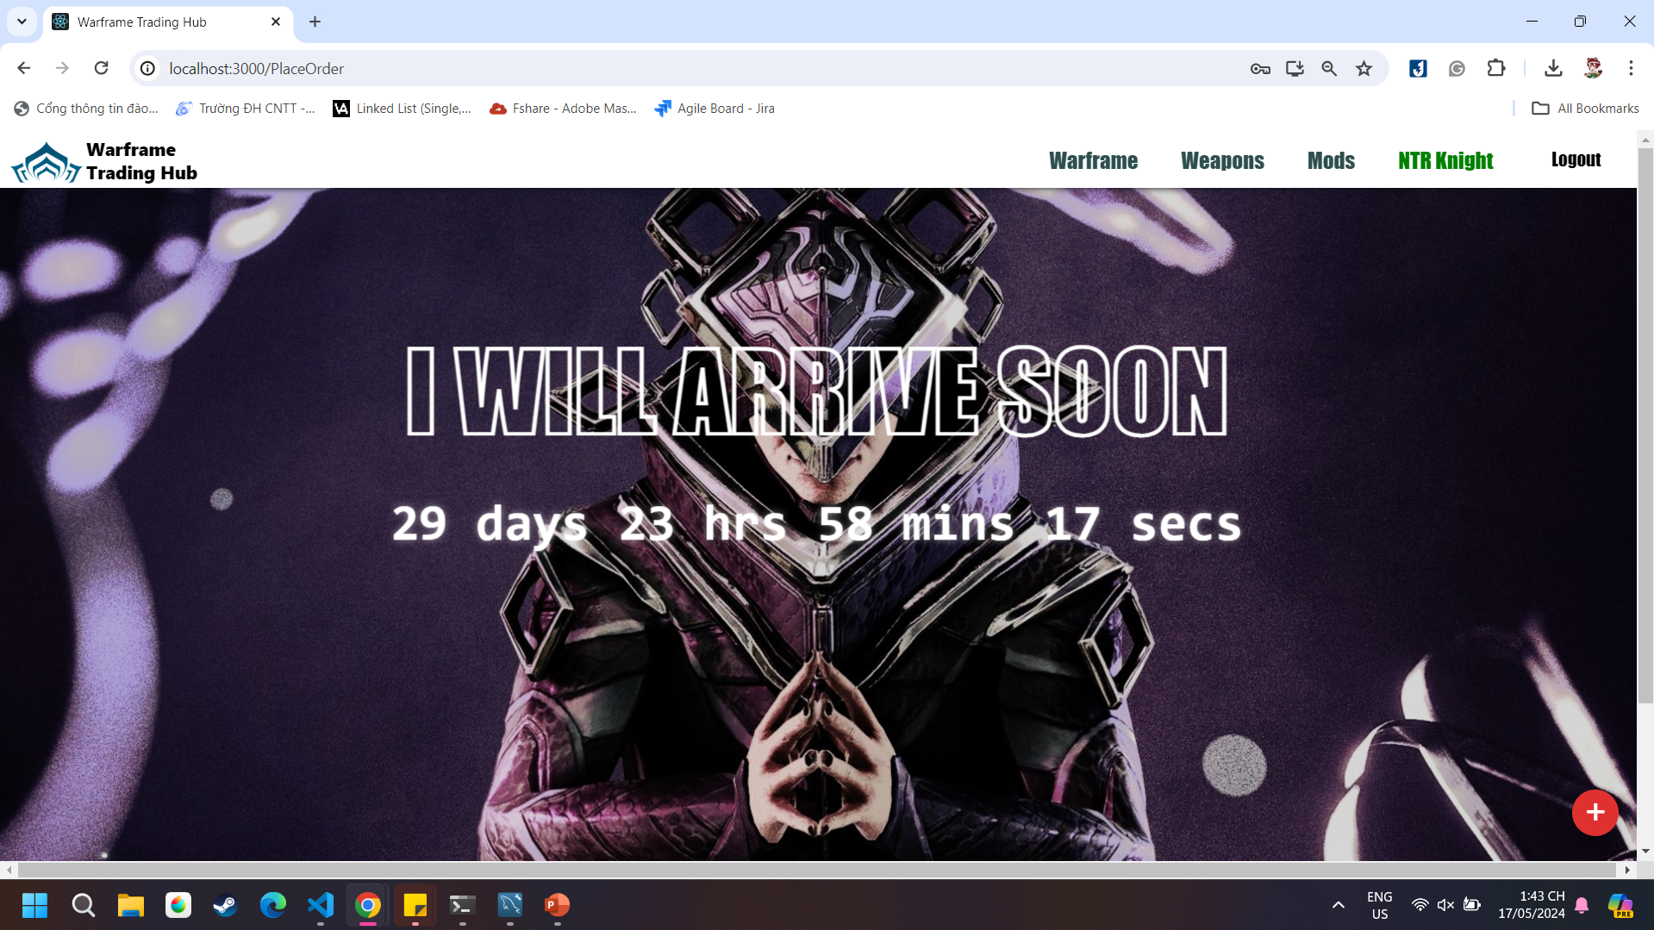
Conclusion
The website is still in a prototype stage, features a single mechanic with simple UI design

Slide 25
What we gained
Knowledge
Foundation
Enjoyment
Idk?
We all have to learn to use the right tools to do this project
Each component of the project’s code is reusable
Despite the project is not easy, but the joy of gaining something is worth it
We only have 3 things

Slide 26
Difficulties
Lacks time
Teamwork
Unstable
scope
Inexperienced

Slide 27
Future Plan
More Features
Reorganize the code

Slide 28
References
warframe.market
Index | Node.js v22.2.0 Documentation, n.d.
PedroTech. (2021, April 2). Full Stack Web Development Course
npm Docs. (n.d.). https://docs.npmjs.com/

Slide 29
Thank you

